Slide 1


Lecture 8
User Defined
Function

Slide 2
Function
Functions:
Useful for breaking the whole program into small sub-program
Easy to identify and debug the errors
Reusable in other program / other script, etc.
Allows concise structure
May hide the important algorithm

Slide 3
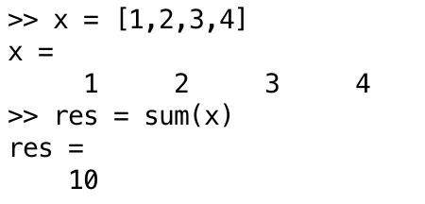
Structure of Function
[Output Argument] = function_name(Input Argument)
Saves the output of the function
Parameter used to execute the function

Slide 4
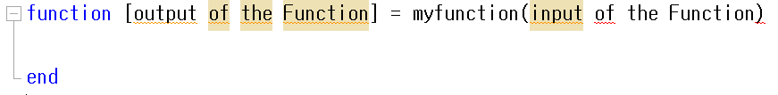
User Defined Function
How to Create a user defined function?:
Define the input and the output
Open a new script file and define the function name and argument first
Write the program inside, utilizing the input of the function and return it to the output

Slide 5
User Defined Function
How to Create a user defined function? (contd):
3. Save the function in the same directory!
4. Call the function using the name used above.

Slide 6
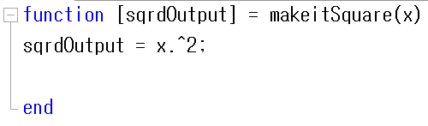
User Defined Function Example
Ex: Making a user-defined function that makes the square of input argument
1~2.

Slide 7
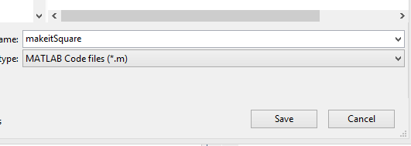
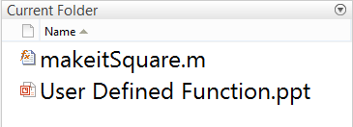
User Defined Function
3.

Slide 8
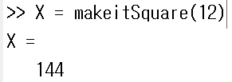
User Defined Function
4. Calling the function:

Slide 9
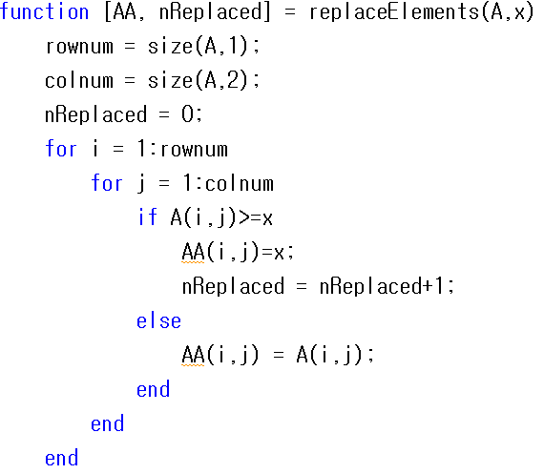
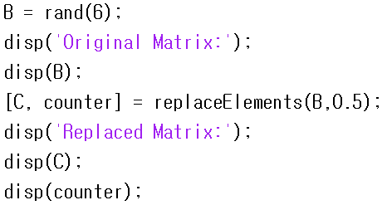
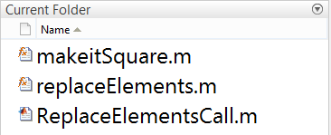
User Defined Function
replaceElements.m (Function)
ReplaceElementsCall.m (Script)

Slide 10
User Defined Function
Important Note: Calling the function
User defined functions only get called by whatever name you saved them into.
Best Strategy: save the function with exactly same name as the name used in function definition line.
The function MUST be in the same folder to get called
(or included in the path)

Slide 11

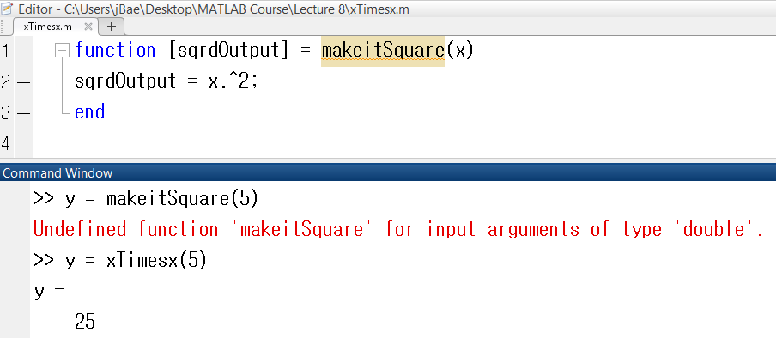
User Defined Function
Example: makeitSquare saved as “xTimesx”

Slide 12
Built-in Function
Local Variable
Variables defined within a function call
Doesn’t ‘live’ outside of the function

Slide 13
Built-in Function
D

Slide 14
Built-in Function
D

Slide 15
Built-in Function
D

Slide 16


Example (Built-in Function)
Input Argument
(Parameter)
Input Argument
(Parameter)
Output Argument

Slide 17
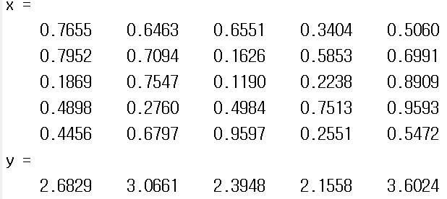
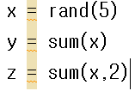
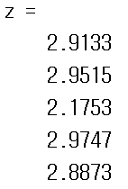
Function
Important Note:
Some function does different operations based on the input argument provided.

Slide 18
User Defined Function
User Defined Function:
You can define your own function
Generally these functions have input arguments and output arguments

Slide 19
User Defined Function
Important Note:
Input/output arguments in function definition is just a place holder!

Slide 20
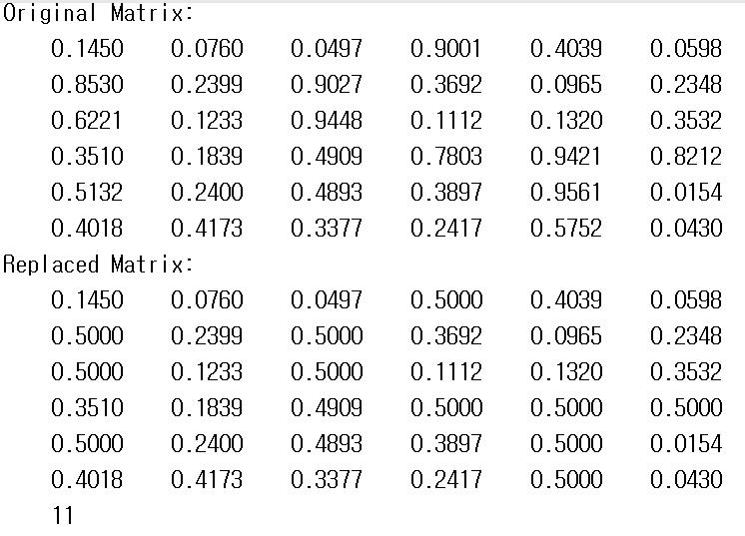
User Defined Function

Slide 21

User Defined Function
Important Note:
Variable defined inside of the function is “local” variable.
Can’t call from outside of function!

Slide 22
Return Statement
When encountered with the “return” statement, the function goes back to wherever it was called
If return statement is absent, then the function runs until the last line, then returns to the code

Slide 23
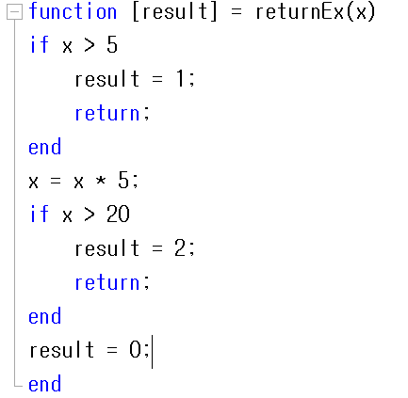
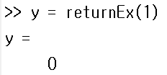
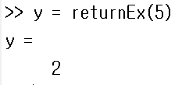
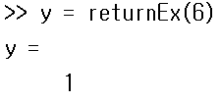
User Defined Function

Slide 24
User Defined Function

